Slide 1
The structure of the FP7:
Funding schemes, Instruments, Calls, Timing

Slide 2
FP7: Framework Program 7th
http://cordis.europa.eu
2007-2013

Slide 3
What is FP7?
The FP main financial tool through which the EU support research and development activities covering almost all scientific disciplines.
What may be financed? Frontier of knowledge, technologic development, demonstration activities, innovation activities, improvement of European infrastructures of research, formation of research; almost anything remotely related with science.
Universities, big companies, SME, public administration, (individual) researchers, (research) institutions, non-European-countries scientists, etc.

Slide 4
Financial Support (I)
FP7 aims to increase the investment on the scientific research up to 3% of European GDP, so that Europe has most dynamic and competitive knowledge-based economy.
Basic Research | 100%
R+D activities | 75%
Demonstration | 50%
Formation Development | 100%
Management | 100%

Slide 5
What’s new in FP7
Emphasis on research themes rather than on instruments.
Significant simplification of its operation (two-steps calls, individual-calls facilities)
Integration of International Cooperation in all four programs.

Slide 6
The Structure
Cooperation – Collaborative Research
Ideas – Frontier Research
People – Marie Curie Actions
Capacities – Research Capacity
JRC
Euratom

Slide 7
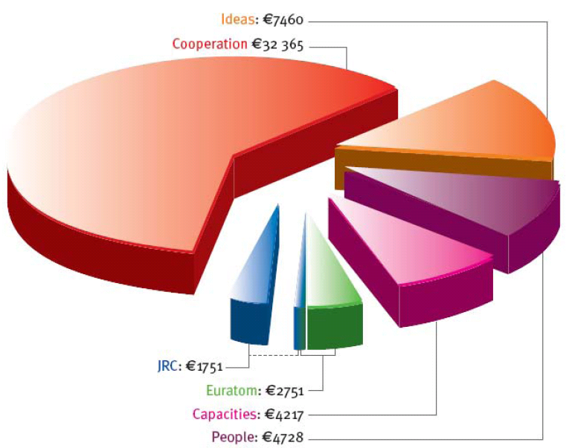
FP7 indicative breakdown (50521M€)

Slide 8
Cooperation
Support will be given to the whole range of research activities carried out in trans-national cooperation, from collaborative projects and networks to the coordination of national research programs.
64% of the bugdet
This action is industry-driven and organised in four sub-programs :
Collaborative research
Joint Technology Initiatives (JTI & ETP)
Coordination of non-Community research programs
International Cooperation (EU & third countries)

Slide 9
Joint Technology Initiatives & European Technology Platforms
JTIs are created from existing ETPs with joint funding from private and public (FP7) sources.
Some ETPs (Stakeholders led by industry):
In the ICT sector: eMobility, ISI, NEM, NESSI.
European Nanoelectronics Initiative Advisory Council (ENIAC)
Hydrogen and Fuel Cell Platform (HFP)
Nanotechnologies for Medical Applications (NanoMedicine)
…
More information on existing ETPs in forthcoming sessions.

Slide 10
Collaborative research
Excellent research projects and networks which are able to attract researchers and investments from Europe and the entire world.
More support on small groups of partners as compared with FP6.
Need for consortium agreement (CA).
Funding Schemes:
Collaborative research projects
Excellence networks
Support/Coordination Actions

Slide 11
Collaborative Research (I): Projects
Research projects carried out by a CA constituted from different countries to develop new knowledge, new technologies and products or joint research resources. (c.f. research themes)
Depending on the size, the scope and the organization we have:
Project | CA | Budget
Focused Research Actions (STREP) | 6-15 partners | 1-4 M€
Integrated Projects (IP) | 10-20 partners | 4-25 M€

Slide 12
Focused Research Projects (SMALL)
Old STREP actions in FP6
GOAL: Well-defined scientific/technological goal, oriented to approach a unique problem.
PARTICIPANT: Research institutes, university & industry (‘SME’).
ACTIVITIES: R+D+i, coordination/management
AVERAGE BUDGET: 1.9 M€ (1-4 M€)
PERIOD: 18-30 months
CA: 6-15 partners
FEATURES: Monothematic (“Project” approach), no demonstration or formation activities. Invariant CA/Schedule.

Slide 13
Integrated Projects (LARGE)
GOAL: Well-defined scientific/technological goal, oriented to obtain specific results including risky research at long term. Meaningful contribution from private/public resources due to its very ambitious goals.
PARTICIPANT: Research institutes, university & industry (‘SME’).
ACTIVITIES: R+D+i (and about it), coordination/management, demonstration and formation activities.
AVERAGE BUDGET: 10 M€ (4 - 25 M€)
PERIOD: 36-60 months
CA: 10-20 partners
FEATURES: Plurithematic: “Program” Approach

Slide 14
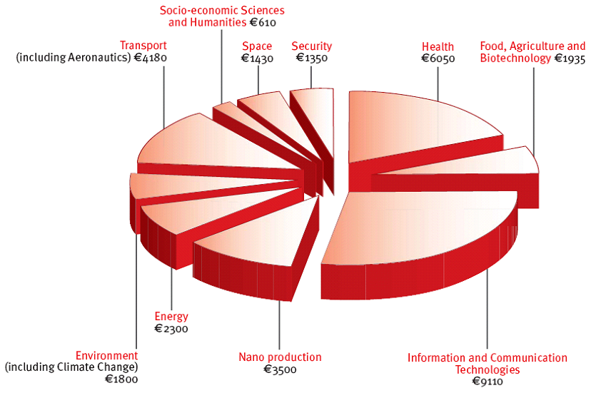
Collaborative research: Themes
(32413M€)

Slide 15
Collab. Res. (II): Networks of Excellence (NoE)
GOAL: To strengthen scientific and technological excellence on a particular research topic through the durable integration of the research capacities of the participants. To overcome the fragmentation of European research by gathering a) the critical mass of resources b) expertise needed to provide European leadership
PARTICIPANT: Research institutes, university & industry (‘SME’).
ACTIVITIES: adaptation of the research lines (‘complementarity’), scientists exchange, development of structures, research training, knowledge diffusion, support to SME technological innovation, analysis of science-society issues related with the subject of the network.
AVERAGE BUDGET: 7 M€ (4 - 15 M€)
PERIOD: 48-60 months
CA: 6-12 partners
FEATURES: CA increase, integration of different research groups

Slide 16
Collab. Res. (III)-a: Coordination Actions (CA)
GOAL: Networking.
PARTICIPANT: Research Institutes, University, Civil Society & Industry (‘SME’).
ACTIVITIES: Any activity which aims to improve the coordination of the research activities: meetings & workshops (for the analysis of the research), people exchange, web-network establishment of European scientific databases.
AVERAGE BUDGET: 1 M€ (0.5 – 1.8 M€)
PERIOD: 18-36 months
CA: 13-26 partners
FEATURES: No research activities, program approach

Slide 17
C. R. (III)-b: Specific Support Activities (SSA)
GOAL: Preparation of future (research) actions. Diffusion of results.
PARTICIPANT: Research Institutes, University, Civil Society & Industry (‘SME’).
ACTIVITIES: Any activity which aims to prepare research activities: meetings & workshops, awards, scientific competitions.
AVERAGE BUDGET: 0.5 M€ (0.03 – 1 M€)
PERIOD: 9-30 months
CA: 1-15 partners
FEATURES: No research activities, project approach, possibility of no CA (only 1participant)

Slide 18
Ideas
7460M€
The Ideas program proposes a trans-European mechanism to support creative scientific research designed to generate new knowledge that opens up new avenues for technological progress and new solutions for social and environmental problems.
This program will enhance the dynamism, creativity and excellence of European research at the frontier of knowledge in all scientific and technological fields, including engineering, socio-economic sciences and the humanities. This action will be overseen by a European Research Council.
Individual projects for brilliant and independent investigators.

Slide 19
IDEAS: Starting Independent Researcher Grant (StG)
People in position of starting their first independent research team (<10years from PhD)
Criteria: Potential of the people, excellence of the project.
€100,000-€400,000/year for 5 years
Salary costs for the participant, and team members may be included.
Open Call: 25 April 2007 (preliminar proposal)
1st stage: 4+1+3 pages (project, resources, CV)
2nd stage: 10+2+4 pages
Budget: 300 M€ (45% to physical sciences)
… possibility of continuation (see next slide)

Slide 20
IDEAS: Advanced Investigator Grant (AdG)
Support project of research excellence in the frontier of knowledge led by brilliant independent researchers in the EU (independent of their nationality). Intended to be for ‘young’-senior researchers.
Criteria: Potential of the people, excellence of the project.
Call to be Opened
Independent:
Can apply for funding ‘alone’
Management of the funding and make decisions
Publish as a senior author
Have access to a reasonable space and facilities to carry out your research

Slide 21
Capacities
The objective of this action is to support research infrastructures, research for the benefit of SMEs and the research potential of European regions (Regions of Knowledge) as well as to stimulate the realization of the full research potential (Convergence Regions) of the enlarged Union and build an effective and democratic European Knowledge society.
Research infrastructures
Research for the benefit of SMEs
Regions of knowledge and support for regional research-driven clusters
Research potential of Convergence Regions
Science in society
Support to the coherent development of research policies
International cooperation
Some of them bridge the gap between Cooperation, People & Ideas (‘horizontality’)

Slide 22
People
Quantitative and qualitative strengthening of human resources in research and technology in Europe by putting into place a coherent set of Marie Curie actions:
Host driven actions (RTN, EST, TOK & SCF/LCF)
Individual driven actions (EIF, OIF & IIF)
Excellence promotion and recognition (EXT, EXA & EXC)
Return and re-integration mechanisms (ERG & IRG)
Co-operation with Member States and Associated Countries
http://cordis.europa.eu/mariecurie-actions/

Slide 23
Funding schemes
3 funding schemes – 5 “instruments”
Collaborative Projects (CP)*
Large Scale Integrating Projects (“IP”)
Small or medium scale focused research actions (“STREP”)
Networks of Excellence (NoE)
Coordination and Support Actions (CSA)
Coordinating or networking actions (“CA”)
Support Actions (“SSA”)
ICT Workprogramme:
budget pre-allocation to instruments !
*SICA – Specific International Co-operation Actions

Slide 24
Budget split per objective
For each Work Programme objective:
A reserved amount for CSAs
support activities won’t need to compete against research projects for funding
A reserved amount for NoE
we won’t fund multiple NoEs to compete with each other
Remaining (main) part of budget committed to Collaborative Projects
minimum percent Integrating Projects, minimum percent Focused Research Actions, the remainder distributed by quality of the proposals

Slide 25
CP - Integrating Projects
Experience of IPs in FP6
Purpose: Ambitious objective driven research with a ‘programme approach’
Target audience: Industry (incl. SMEs), research institutions. Universities – and in some cases potential end-users
Typical duration: 36-60 months
Optimum consortium: 10-20 participants
Total EU contribution: €4-25m (average around €10m)
Flexibility in implementation:
Update of workplan
Possibility for competitive calls for enlargement of consortium

Slide 26
CP – Focused projects
Experience of STREPs in FP6
Purpose: Objective driven research more limited in scope than an IP
Target audience: Industry including SMEs, research institutes, universities
Typical duration: 18-36 months
Optimum consortium: 6-15 participants
Total EU contribution: €1-4 m (average around €2m)
Fixed workplan and fixed partnership for duration

Slide 27
Networks of excellence
Experience of NoEs in FP6
Purpose: Durable integration of participants’ research activities
Target audience: research institutions, universities, mainly indirectly: industry – trough governing boards etc
Typical duration: 48-60 months (but indefinite integration!)
Optimum consortium: 6-12 participants
Total EU contribution: €4-10m (average around €5m)
Flexibility in implementation:
Update of workplan
Possibility to add participants through competitive calls

Slide 28
CSAs - Coordination actions
Experience of CAs in FP6
Purpose: Co-ordination of research activities
Target Audience: Research institutions, universities, industry incl. SMEs
Typical duration: 18-36 months
Optimum consortium: 13-26 participants
Total EU contribution: €0.5-2m (average around €1m)
Fixed overall workplan and partnership for the duration

Slide 29
Upper funding limits

